Slide 1
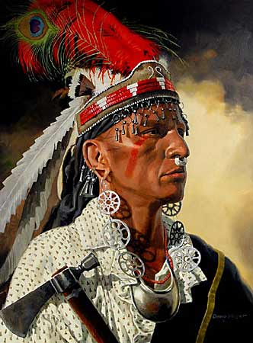
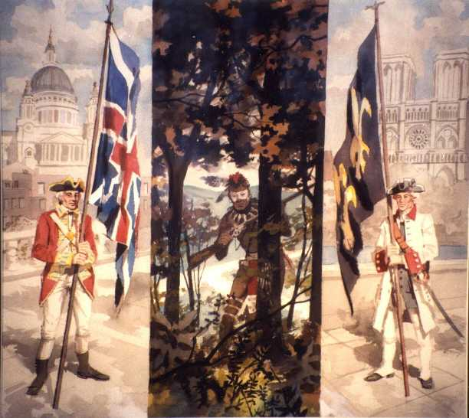
The French and Indian War
“You and the French are like two edges of a pair of shears, and we are the cloth that is cut to pieces between them.”
– Native American to an English man

Slide 2
France Claims Western Lands
French exploring interior of America
Late 1600’s – France had claimed the Ohio River Valley, the Mississippi River Valley, and the great lake region.
Louisiana (La Salle) stretched from the Appalachian Mountains to the Rocky Mountains
PAGE 132 and 134

Slide 3
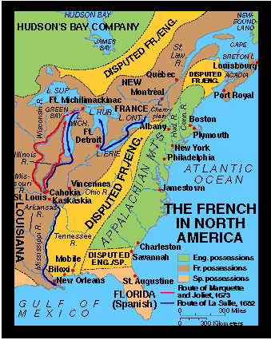

Slide 4
French Main Settlements
Quebec and Montreal
Located along the St. Lawrence River
New Orleans – Mississippi River
*Why are these settlements so important?

Slide 5
French Population
1760 – NEW FRANCE had about 80,000 people (England had over 1 million)
*Why is their such a difference in population?

Slide 6
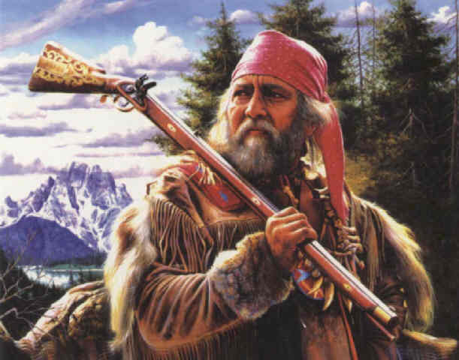
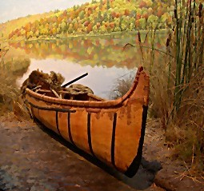
French were mostly fur trappers who traded with the Natives
Furs, guns, knives, iron pots, etc.

Slide 7
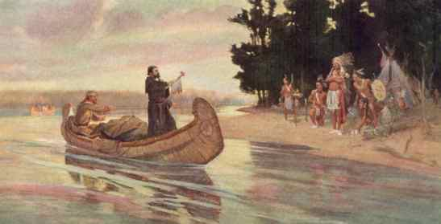
Native American Alliances
*English competed with the French for furs
*Native American groups competed to supply Europeans with furs

Slide 8
Native American Alliances
*The fur trade created economic and military rivalries and alliances between the Native Americans and the Europeans.
These alliances between the Natives and Europeans led to their involvement in the war.
Algonquin and Huron sided with the French while the Iroquois became divided

Slide 9
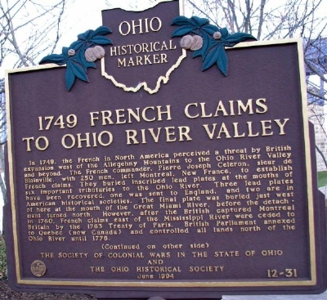
*Conflict in the Ohio River Valley
Seeds of war planted by when British fur traders moved into the Ohio River Valley in the 1750’s.
British land companies were also planning to settle colonists there.

Slide 10
War Begins and Spreads
To keep British out of the valley, they destroy a British trading post (Pickawillany)
The French then built forts to protect the region linking their Canadian and Louisiana settlements

Slide 11
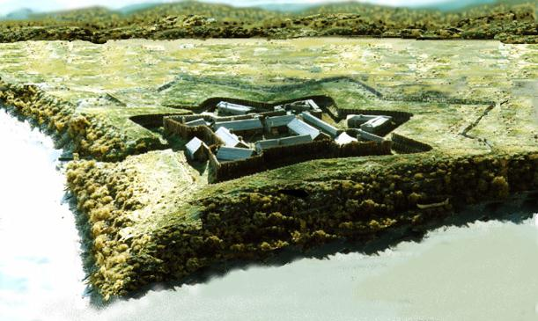
Virginia Reacts
Send major George Washington to ask the French to leave
English build a fort close to present day Pittsburg
French seize the fort before they were done and name it Fort Duquesne
“He told me the Country belogn’d to them, that no English Man had a right to trade upon them Waters; & that he had Orders to make every Person Prisoner that attempted it on the Ohio or the Waters on it.” – G.W.

Slide 12
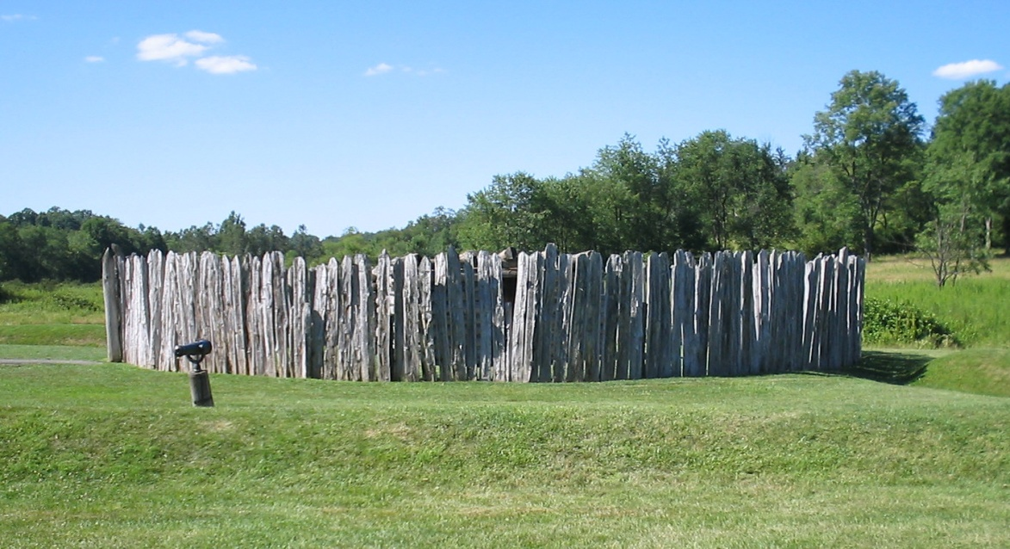
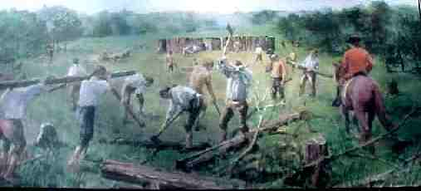
Fort Necessity
Washington was on his way to Fort Duquesne when he heard of its surrender
Instead, he built a small fort but was attacked and forced to surrender (July 3, 1754)

Slide 13
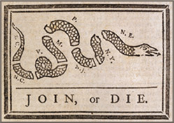
*Albany Plan of Union
While the fighting was beginning, representatives were trying to get the Iroquois to fight with the colonists (English)
*Ben Franklin was trying to get the colonists to join together for defensive purposes
Council that could collect taxes, make treaties, raise an army, and make new settlements.

Slide 14
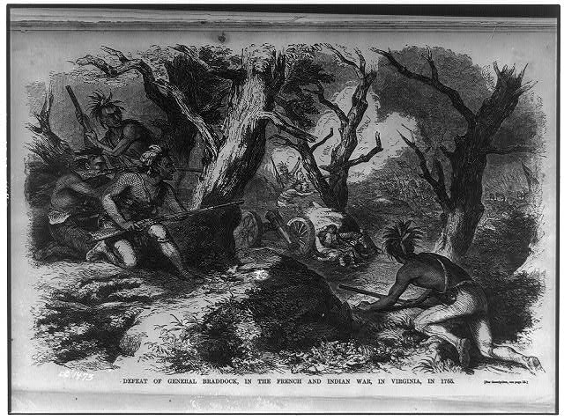
Braddock’s Defeat
July 9, 1755: Marched on Fort Duquesne with 2 regiments and Washington
They were ambushed and destroyed
1000 English men were killed or wounded
The English new it would take more to defeat the French

Slide 15
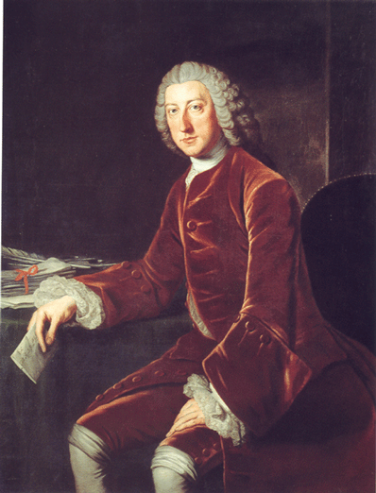
The British Take Quebec
William Pitt – Sec. of State
New Philosophy on the war
Sent more troops, nations top generals and more money to win the war

Slide 16
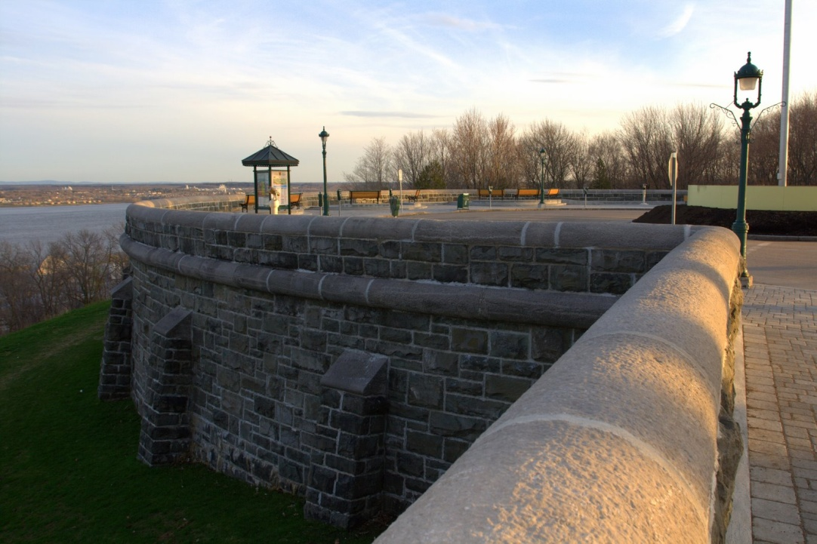
Turning Point
Quebec – cliff 300 feet above the St. Lawrence River loaded with cannons and troops
For 2 months sailed around looking for a way to capture it – eventually found an unguarded path up the cliff

Slide 17
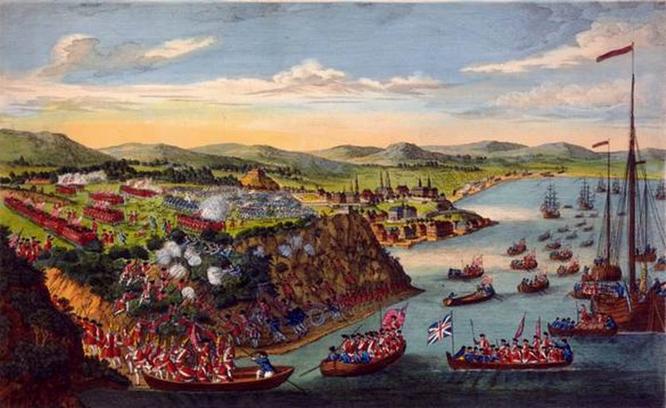
Turing Point
At night fall 4,000 British snuck up the cliff and waited
Surprised the French in the morning
Montreal falls within the year
*Why do you think Battle of Quebec is a turning point in the war?

Slide 18
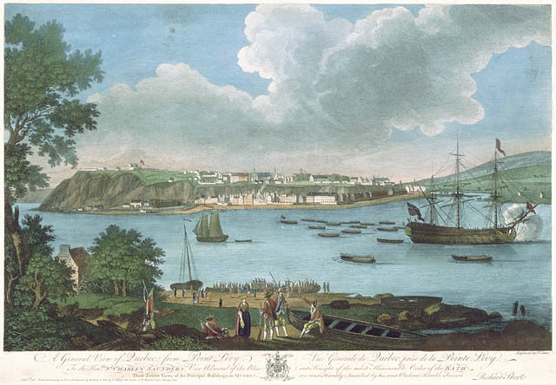

Slide 19
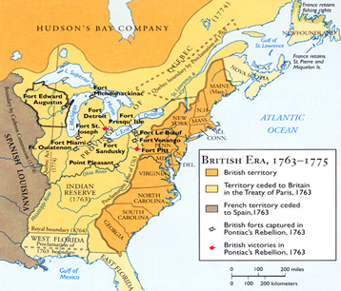
*Treaty of Paris*
Britain received all land east of the Mississippi
Spain received all land west of the Mississippi and New Orleans for its help
*Britain got Florida from Spain in exchange for Cuba and the Philippines
*Treaty ended the war as well as French power in North America

Slide 20
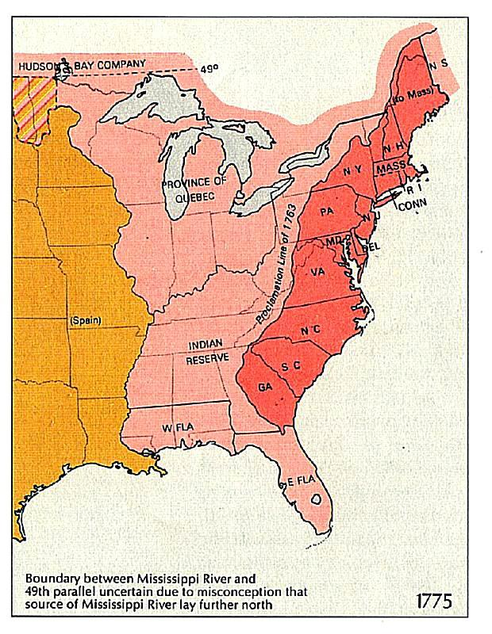
Pontiac’s Rebellion
*Proclamation of 1763 – forbid colonists to settle west of Appalachian Mountains
B/C new they couldn’t protect them against Natives or French
Colonists are not happy about this; feel it is their right to settle the land

Slide 21
This powerpoint was kindly donated to
www.worldofteaching.com
http://www.worldofteaching.com
Is home to well over a thousand powerpoints submitted by teachers. This a free site. Please visit and I hope it will help in your teaching
Notes:
21

